Slide 1

BRITISH AIRWAYS
Data Science: Building a Predictive model to understand factors that influence buying behavior
Sept 2023

Slide 2
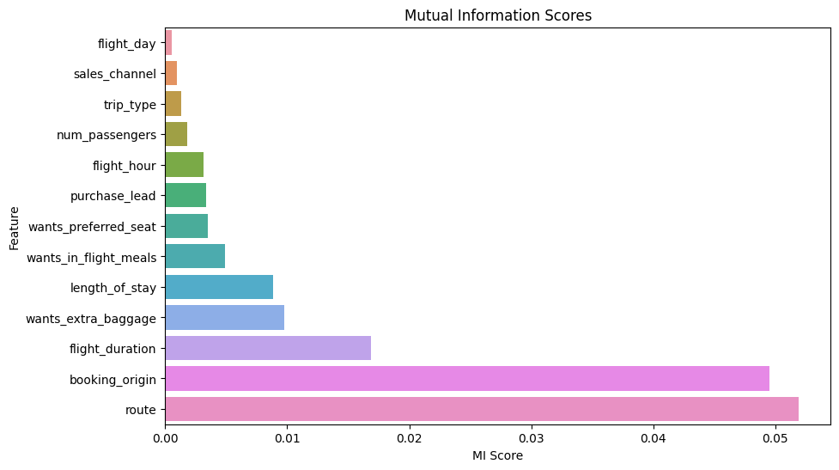
PREDICTIVE MODEL RESULTS & INSIGHTS
Random Forest Classifier model – [Test Set Accuracy: 85.36, AUC score: 0.554]
Decision Tree Model – [Test Set Accuracy: 82.68, AUC score: 0.554]
XGB Model - [Test Set Accuracy: 85.05, AUC score: 0.542]
Inference:
Random forest model gave the highest accuracy at 85.36 and AUC score of 0.554
Conclusion:
From fig 1, factors influencing customer buying behaviour in descending order include:
Route
Booking_origin
Flight_duration
Wants_extra_baggage
Length_of_stay
Wants_in_flight_meals
Wants_preferred_seat
Purchase_lead
Flight_hour
Num_passengers
Trip_type
Sales_channel
Flight_day
Fig 1 Mutual Information Scores for buying behaviour features

